Slide 1

EE-371 : Control Systems
Lecture#27
7.6 Steady-State Error for Non unity
Feedback Systems
7.7 Sensitivity
Textbook: Chapter # 07 (5th edition)
Text Book: Control Systems Engineering by Norman S. Nise 5th Edition
Instructor: Ms Neelma Naz
Class: BEE 12 C/D
School of Electrical Engineering and Computer Science
Department of Electrical Engineering

Slide 2
7.6 Steady-State Error for Nonunity Feedback Systems

Slide 3
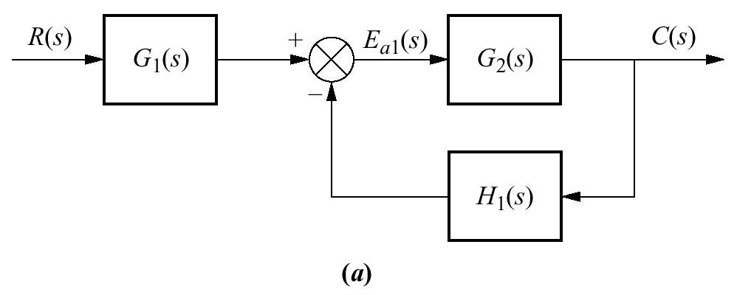
Nonunity Feedback System
The feedback path of a control system may be a pure gain other than unity or may have some dynamic representation
controller and plant
input transducer
Control systems may not have unity feedback
because of the compensation used to improve performance
or
because of the physical model for the system
A general feedback system
feedback
E(s) = R(s) — C(s)
???

Slide 4
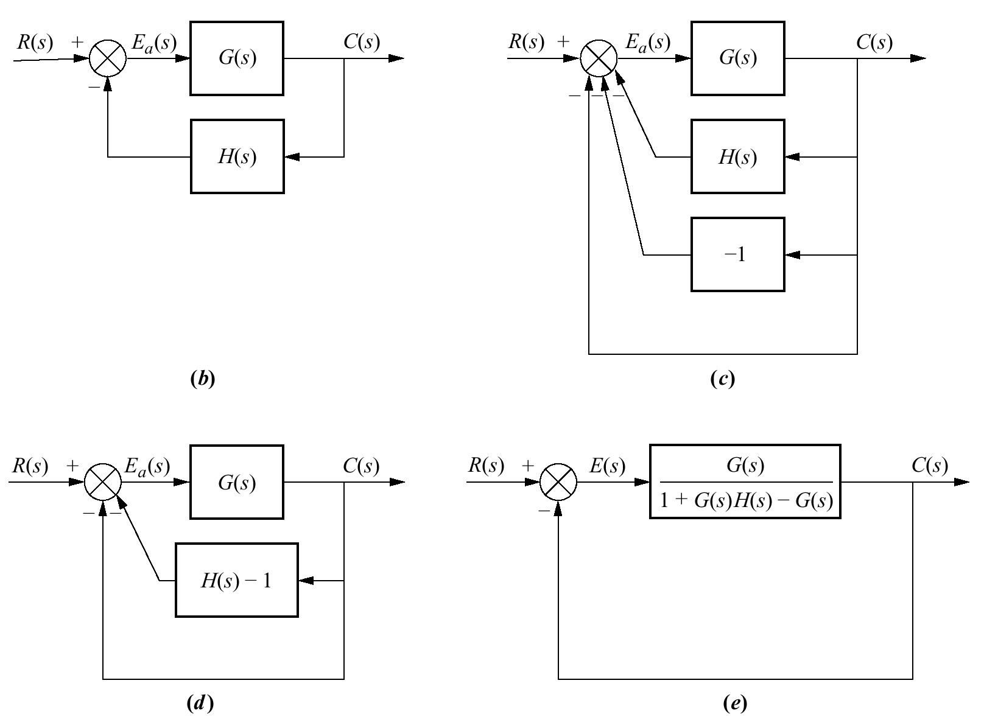
Forming an equivalent unity feedback system from a nonunity feedback system through block diagram manipulation
G(s) = G₁(s)G₂(s)
H(s) = H₁(s)/G₁(s)
The error E_{a}(s) is not the difference between the input and the output
(b)
Actuation signal
Unity Feedback System
E(s) = R(s) — C(s)

Slide 5
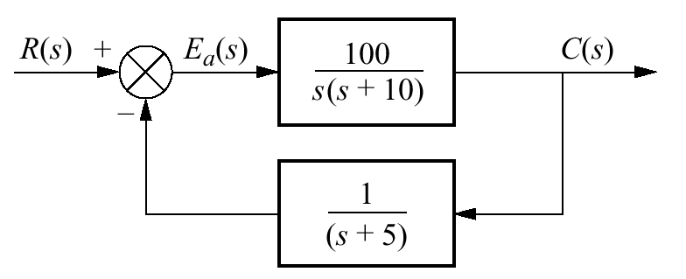






Example 7.8
Steady-State Error for Nonunity Feedback Systems
PROBLEM: For the system shown in the Figure, find the system type, the appropriate error constant associated with the system type, and the steady-state error for a unit step input. Assume input and output units are the same.
SOLUTION:
System Type ???
Convert the system into an equivalent unity feedback system
static error constant
The steady-state error
System Type ???

Slide 6
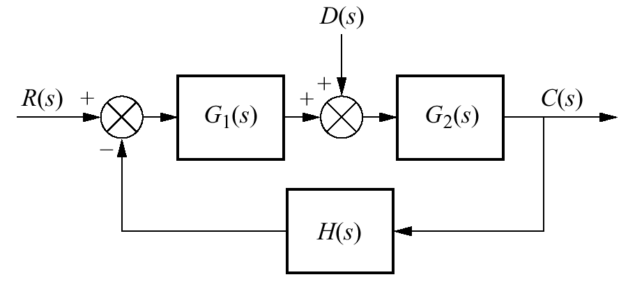






Deriving a general equation for the steady-state error of a system with disturbance and nonunity feedback
For zero error,
Assuming step inputs and step disturbances
The two equations can be satisfied if
(1) the system is stable,
(2) G1(s) is a Type 1 system,
(3) G2(s) is Type 0 system
(4) H(s) is Type 0 system with unity dc gain

Slide 7
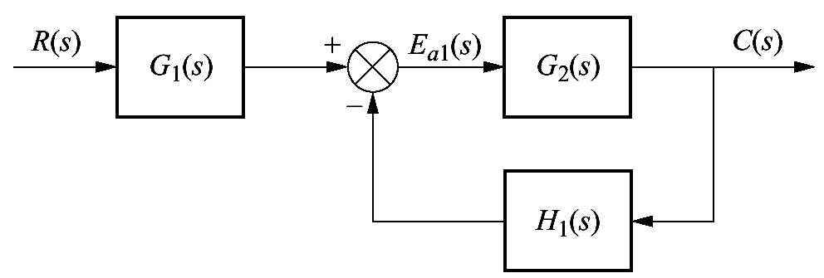
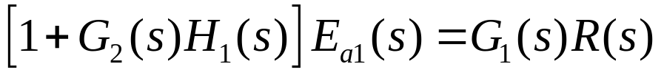
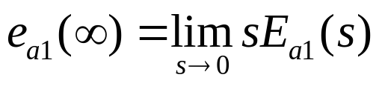
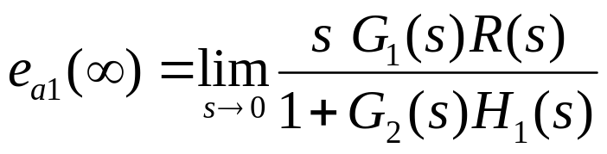
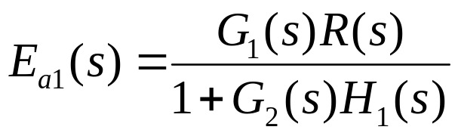
Steady-State value of the actuating signal, E_{a1}
no restriction that the input and output units be the same
Applying final value theorem:

Slide 8
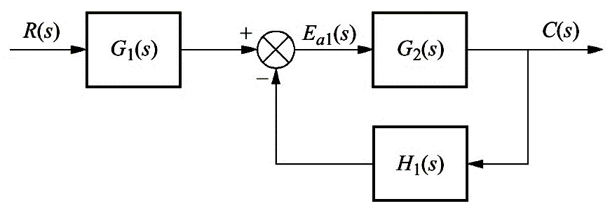
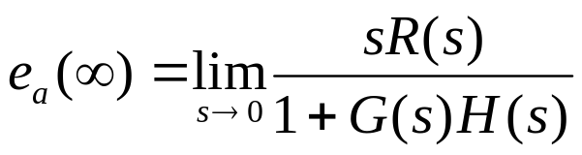


Steady-State Actuating Signal for Nonunity Feedback Systems
Example 7.9
PROBLEM: Find the steady-state actuating signal for the system shown in the Figure for a unit step input. Repeat for a unit ramp input.
For step input R(s)=1/s
For ramp input R(s)=1/s²

Slide 9
7.7 Sensitivity

Slide 10
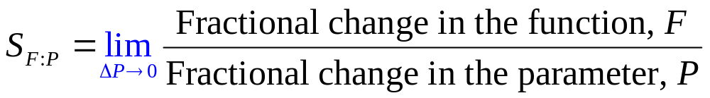
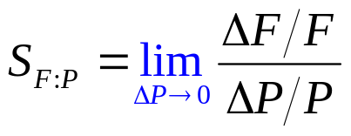
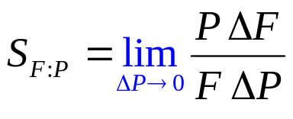
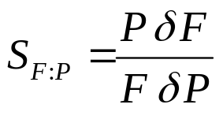
Definition
The extent to which changes in system parameters affect system transfer functions is called sensitivity.
OR
Sensitivity is ratio of the fractional change in the function to the fractional change in the parameter
as
the fractional change of the parameter approaches zero

Slide 11
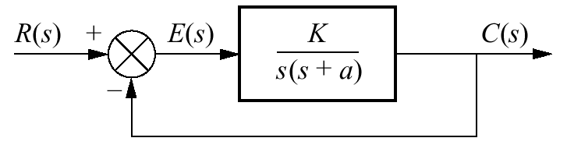




Example 7.10
Sensitivity of a Closed-Loop Transfer Function
PROBLEM: Given the system in the Figure, calculate the sensitivity of the closed-loop transfer function to changes in the parameter a. How would you reduce the sensitivity?
SOLUTION:
The closed-loop transfer function is
For any value of s, an increase in K reduces the sensitivity of the closed-loop transfer function to changes in the parameter a

Slide 12
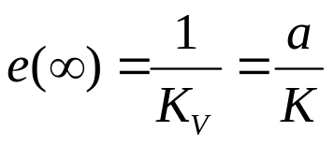
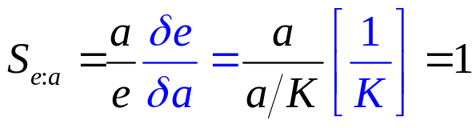
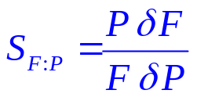
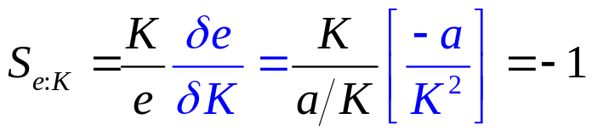
Example 7.11
Sensitivity of Steady-State Error with Ramp Input
PROBLEM: For the system shown in the Figure, find the sensitivity of the steady-state error to changes in parameter K and parameter a with ramp inputs.
SOLUTION:
The steady-state error for the system is
The negative sign indicates a decrease in e(∞) for an increase in K

Slide 13
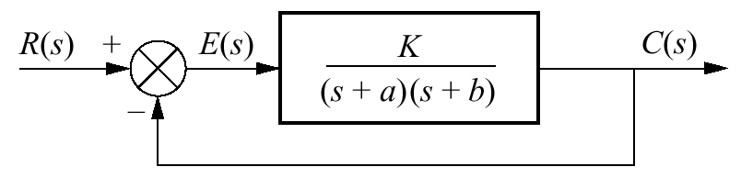



Example 7.12
Sensitivity of Steady-State Error with Step Input
PROBLEM: Find the sensitivity of the steady-state error to changes in parameter K and parameter a for the system shown in the Figure with a step input.
SOLUTION:
The steady-state error for this Type 0 system is

Slide 14

???

